Slide 1
Simulation and Analysis of Image detection Algorithm (Deep learning) for Parallel Hardware Implementation
Guided By
Prof. Sheera Shamsudeen
Biju (Intel)
Submitted By
Aswathy Raj
MCA S6

Slide 2
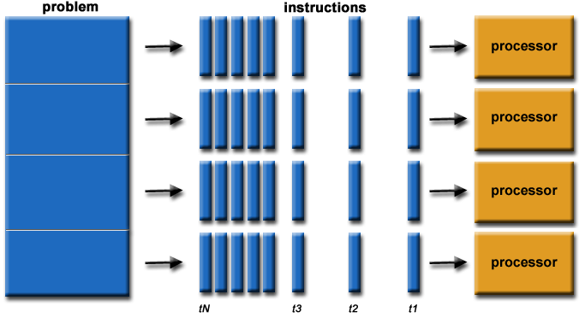
Introduction
1.Parallel processing: A mode of operation in which a process is split into parts, which are executed simultaneously on different processors attached to the same computer.

Slide 3
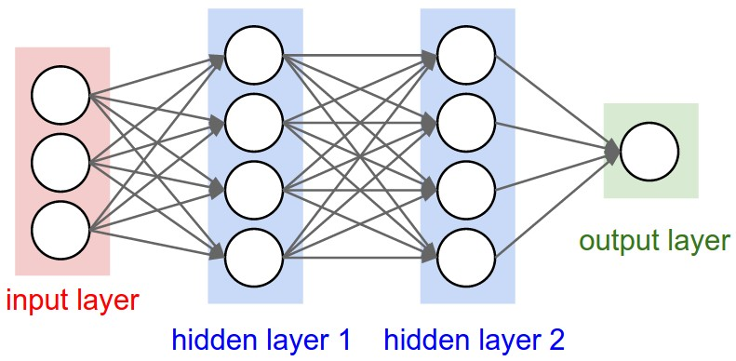
2.Image detection Algorithm
CNN (Convolutional Neural Networks)

Slide 4
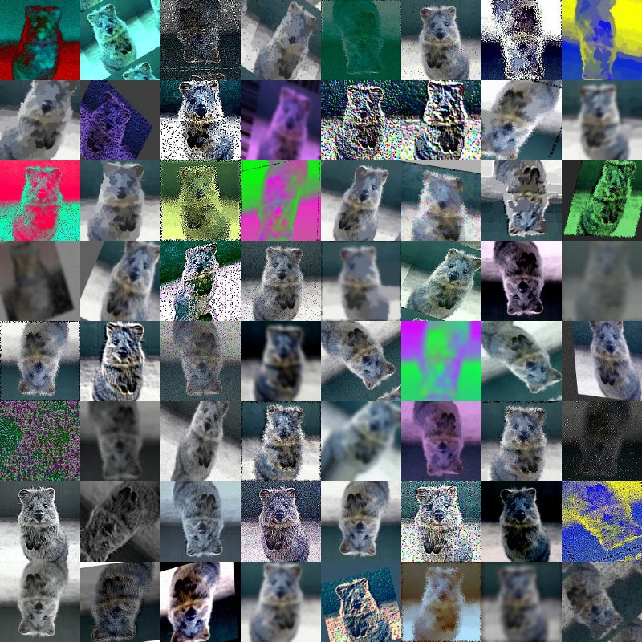
Pre Processing Stage
We’re going to do a random
combination of the following
to the images:
Crop parts of the image
Flip image horizontally
Adjust hue, contrast and saturation
Splitting Our Dataset
Building a Convolutional
Neural Network

Slide 5
Proposed System
Simple Logistics regression Algorithm
Develop a Frame Work for Parallel Implementation
Visualization Tools Using Python
Used to Visualize the number of function calls and Buffer reads
Replace the Algorithm with Image Detection Algorithm which is Developed using CNN

Slide 6
Thank you

